Slide 1
Midterm Exam Review
Weeks 1-7
Chapters 1-11

Slide 2
Chapter 1 Key Topics
What Operating Systems Do
Computer-System Organization
Computer-System Architecture
Operating-System Structure
Operating-System Operations
Process Management
Memory Management
Storage Management
Protection and Security
Kernel Data Structures
Computing Environments
Open-Source Operating Systems

Slide 3
Chapter 2 Key Topics
Operating System Services
User Operating System Interface
System Calls
Types of System Calls
System Programs
Operating System Design and Implementation
Operating System Structure
Operating System Debugging
Operating System Generation
System Boot

Slide 4
Key Topics Chapter 3
Process Concept
Process Scheduling
Operations on Processes
Inter-process Communication
Examples of Inter -Process Communication (IPC) Systems
Communication in Client-Server Systems

Slide 5
Key Topics Chapter 4
Overview
Multicore Programming
Multithreading Models
Thread Libraries
Implicit Threading
Threading Issues
Operating System Examples

Slide 6
Chapter 5: Process Scheduling
Basic Concepts
Scheduling Criteria
Scheduling Algorithms
Thread Scheduling
Multiple-Processor Scheduling
Real-Time CPU Scheduling
Operating Systems Examples
Algorithm Evaluation

Slide 7
Chapter 6 - Synchronization
Background
The Critical-Section Problem
Peterson’s Solution
Synchronization Hardware
Mutex Locks
Semaphores
Classic Problems of Synchronization
Monitors
Synchronization Examples
Alternative Approaches

Slide 8
Chapter 7 - Deadlocks
System Model
Deadlock Characterization
Methods for Handling Deadlocks
Deadlock Prevention
Deadlock Avoidance
Deadlock Detection
Recovery from Deadlock

Slide 9
Chapter 8: Memory Management Strategies
Background
Swapping
Contiguous Memory Allocation
Segmentation
Paging
Structure of the Page Table
Example: The Intel 32 and 64-bit Architectures
Example: ARM Architecture

Slide 10
Chapter 9: Virtual-Memory Management
Background
Demand Paging
Copy-on-Write
Page Replacement
Allocation of Frames
Thrashing
Memory-Mapped Files
Allocating Kernel Memory
Other Considerations
Operating-System Examples

Slide 11
Chapter 10: File System
File Concept
Access Methods
Disk and Directory Structure
File-System Mounting
File Sharing
Protection

Slide 12
Chapter 11: Implementing File Systems
File-System Structure
File-System Implementation
Directory Implementation
Allocation Methods
Free-Space Management
Efficiency and Performance
Recovery
NFS
Example: WAFL File System

Slide 13
Section 1.1.1
True/False
All computer systems have some sort of user interaction.

Slide 14
Section 1.2.1
What role do device controllers and device drivers play in a computer system?
Answer: A general-purpose computer system consists of CPUs and multiple device controllers that are connected through a common bus. Each device controller is in charge of a specific type of device. The device controller is responsible for moving the data between the peripheral devices that it controls and its local buffer storage. Typically, operating systems have a device driver for each device controller. This device driver understands the device controller and presents a uniform interface for the device to the rest of the operating system.

Slide 15
Section 1.5.1
What are some other terms for kernel mode?
  supervisor mode
  system mode
  privileged mode
  All of the above

Slide 16
Section 1.5.1
The two separate modes of operating in a system are
  supervisor mode and system mode
  kernel mode and privileged mode
  physical mode and logical mode
  user mode and kernel mode

Slide 17
Section 1.11.8
Embedded computers typically run on a ____ operating system.
  real-time
  Windows XP
  Network
  clustered

Slide 18
Section 2.4
_____ is not one of the major categories of system calls.
  Process control
  Communications
  Protection
  Security

Slide 19
Section 2.4.1
The Windows CreateProcess() system call creates a new process. What is the equivalent system call in UNIX:
  NTCreateProcess()
  process()
  fork()
  getpid()

Slide 20
Section 2.4.3
True/False
Many operating system merge I/O devices and files into a combined file because of the similarity of system calls for each.

Slide 21
Section 2.7.3
A microkernel is a kernel ____.
  containing many components that are optimized to reduce resident memory size
  that is compressed before loading in order to reduce its resident memory size
  that is compiled to produce the smallest size possible when stored to disk
  that is stripped of all nonessential components

Slide 22
Section 2.7.4
_____ allow operating system services to be loaded dynamically.
  Virtual machines
  Modules
  File systems
  Graphical user interfaces

Slide 23
Section 3.1.1
The ____ of a process contains temporary data such as function parameters, return addresses, and local variables.
  text section
  data section
  program counter
  stack

Slide 24
Section 3.1.3
A process control block ____.
  includes information on the process's state
  stores the address of the next instruction to be processed by a different process // program account
  determines which process is to be executed next
  is an example of a process queue

Slide 25
Section 3.1.2
Name and describe the different states that a process can exist in at any given time.
Answer: The possible states of a process are: new, running, waiting, ready, and terminated. The process is created while in the new state. In the running or waiting state, the process is executing or waiting for an event to occur, respectively. The ready state occurs when the process is ready and waiting to be assigned to a processor and should not be confused with the waiting state mentioned earlier. After the process is finished executing its code, it enters the termination state.

Slide 26
Section 3.2.2
Explain the difference between an I/O-bound process and a CPU-bound process.
Answer: The differences between the two types of processes stem from the number of I/O requests that the process generates. An I/O-bound process spends more of its time seeking I/O operations than doing computational work. The CPU-bound process infrequently requests I/O operations and spends more of its time performing computational work.

Slide 27
Section 3.3.1
Ordinarily the exec() system call follows the fork(). Explain what would happen if a programmer were to inadvertently place the call to exec() before the call to fork().
Answer: Because exec() overwrites the process, we would never reach the call to fork() and hence, no new processes would be created. Rather, the program specified in the parameter to exec() would be run instead.

Slide 28
Exercise 3.2
Describe the actions taken by a kernel to context-switch between processes
Answer:
In general, the operating system must save the state of the currently running process and restore the state of the process scheduled to be run next. Saving the state of a process typically includes the values of all the CPU registers in addition to memory allocation. Context switches must
also perform many architecture-specific operations, including flushing data and instruction caches.

Slide 29
Exercise 3.6
Explain the circumstances when the line of code marked printf ("LINE J") in Figure is reached.
Answer:
The call to exec() replaces the address space of the process with the program specified as the parameter to exec(). If the call to exec() succeeds, the new program is now running and control from the call to exec() never returns. In this scenario, the line printf("Line J");
would never be performed. However, if an error occurs in the call to exec(), the function returns control and therefor the line printf("Line J"); would be performed.

Slide 30
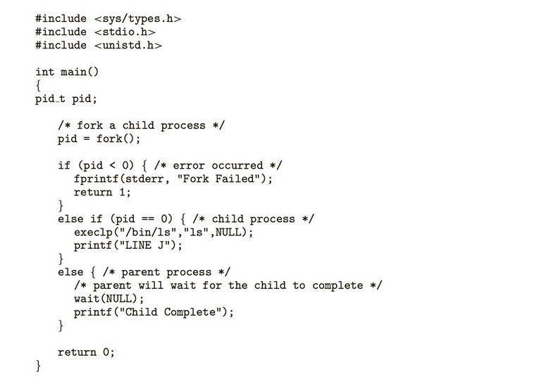

Slide 31
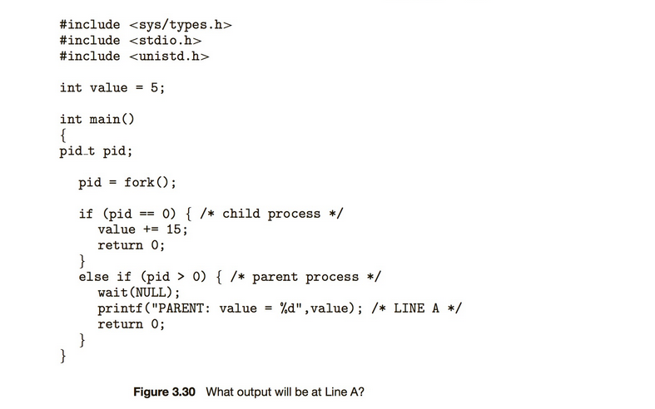
Optional Practice – Page 147

Slide 32
Optional Exercise
Using the program shown in Figure 3.30, explain what the output will be at Line A.
Answer:
The result is still 5 as the child updates its copy of value. When control returns to the parent, its value remains at 5.

Slide 33
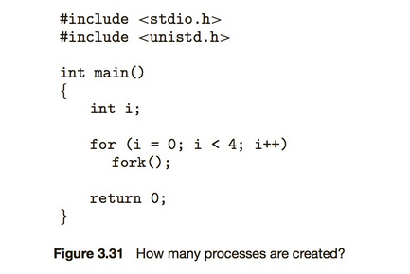
Optional Practice – 3.1

Slide 34
Optional Practice 3.1 answer
Including the initial parent process, how many processes are created by the program shown in Figure 3.31?
Answer:
There are 8 processes created.
Parent1
Child1
Child1 becomes Parent2 for Child2
Child2 becomes Parent3 for Child3
Child3 becomes Parent4 for Child4

Slide 35
Exercise 4.11
As described in Section 4.7.2, Linux does not distinguish between processes and threads. Instead, Linux treats both in the same way, allowing a task to be more akin to a process or a thread depending on the set of flags passed to the clone() system call. However, many
operating systems—such as Windows XP and Solaris—treat processes and threads differently. Typically, such systems use a notation wherein the data structure for a process contains pointers to the separate threads
belonging to the process. Contrast these two approaches for modeling processes and threads within the kernel.

Slide 36
Exercise 4.11 Answer
Answer:
On one hand, in systems where processes and threads are considered as similar entities, some of the operating system code could be simplified. A scheduler, for instance, can consider the different processes and threads on an equal footing without requiring special code to examine the threads associated with a process during every scheduling step. On the other hand, this uniformity could make it harder to impose process-wide resource constraints in a direct manner. Instead, some extra complexity is required to identify which threads correspond to which process and perform the relevant accounting tasks.

Slide 37
Example Question – Section 3.1.1
The ____ of a process contains temporary data such as function parameters, return addresses, and local variables.
  text section
  data section
  program counter
  stack

Slide 38
Example Question – Section 3.1.1
The ____ of a process contains temporary data such as function parameters, return addresses, and local variables.
  text section
  data section
  program counter
  stack

Slide 39
Example Question – Section 3.1.2
A process may transition to the Ready state by which of the following actions?
  Completion of an I/O event
  Awaiting its turn on the CPU
  Newly-admitted process
  All of the above

Slide 40
Example Question – Section 3.1.2
A process may transition to the Ready state by which of the following actions?
  Completion of an I/O event
  Awaiting its turn on the CPU
  Newly-admitted process
  All of the above

Slide 41
Example Question – Section 3.1.3
A process control block ____.
  includes information on the process's state
  stores the address of the next instruction to be processed by a different process
  determines which process is to be executed next
  is an example of a process queue

Slide 42
Example Question – Section 3.1.3
A process control block ____.
  includes information on the process's state
  stores the address of the next instruction to be processed by a different process
  determines which process is to be executed next
  is an example of a process queue

Slide 43
Example Question – Section 3.2.1
The list of processes waiting for a particular I/O device is called a(n) ____.standby queue
  device queue
  ready queue
  interrupt queue

Slide 44
Example Question – Section 3.2.1
The list of processes waiting for a particular I/O device is called a(n) ____.standby queue
  device queue
  ready queue
  interrupt queue

Slide 45
Example Question – Section 3.2.3
A _________________ saves the state of the currently running process and restores the state of the next process to run.
  save-and-restore
  state switch
  context switch
  none of the above

Slide 46
Example Question – Section 3.2.3
A _________________ saves the state of the currently running process and restores the state of the next process to run.
  save-and-restore
  state switch
  context switch
  none of the above

Slide 47
Example Question – Section 4.1.1
Pthreads refers to ____.
  the POSIX standard.
  an implementation for thread behavior.
  a specification for thread behavior.
  an API for process creation and synchronization.

Slide 48
Example Question – Section 4.1.1
Pthreads refers to ____.
  the POSIX standard.
  an implementation for thread behavior.
  a specification for thread behavior.
  an API for process creation and synchronization.

Slide 49
Example Question – Section 4.3.3
The ____ multithreading model multiplexes many user-level threads to a smaller or equal number of kernel threads.
  many-to-one model
  one-to-one model
  many-to-many model
  many-to-some model

Slide 50
Example Question – Section 4.3.3
The ____ multithreading model multiplexes many user-level threads to a smaller or equal number of kernel threads.
  many-to-one model
  one-to-one model
  many-to-many model
  many-to-some model

Slide 51
Example Question – Section 4.6.2
Which of the following would be an acceptable signal handling scheme for a multithreaded program?
  Deliver the signal to the thread to which the signal applies.
  Deliver the signal to every thread in the process.
  Deliver the signal to only certain threads in the process.
  All of the above

Slide 52
Example Question – Section 4.6.2
Which of the following would be an acceptable signal handling scheme for a multithreaded program?
  Deliver the signal to the thread to which the signal applies.
  Deliver the signal to every thread in the process.
  Deliver the signal to only certain threads in the process.
  All of the above

Slide 53
Example Question – Section 4.4.1
Which of the following statements regarding threads is false?
  Sharing is automatically provided in Java threads.
  Both Pthreads and Win32 threads share global data.
  The start() method actually creates a thread in the Java virtual machine.
  The Java method join() provides similar functionality as the WaitForSingleObject in Win32.

Slide 54
Example Question – Section 4.4.1
Which of the following statements regarding threads is false?
  Sharing is automatically provided in Java threads.
  Both Pthreads and Win32 threads share global data.
  The start() method actually creates a thread in the Java virtual machine.
  The Java method join() provides similar functionality as the WaitForSingleObject in Win32.

Slide 55
Example Question – Section 4.2
According to Amdahl's Law, what is the speedup gain for an application that is 60% parallel and we run it on a machine with 4 processing cores?
  1.82
  .7
  .55
  1.43

Slide 56
Example Question – Section 4.2
According to Amdahl's Law, what is the speedup gain for an application that is 60% parallel and we run it on a machine with 4 processing cores?
  1.82
  .7
  .55
  1.43

Slide 57

Amdahl’s Law
If S is the portion of the application that must be performed serially on a system with N processing cores, the formula appears as follows:
60% parallel and we run it on a machine with 4 processing cores – 40% is serial.
1.82 = 1/0.4 + (1-0.4)/4

Slide 58
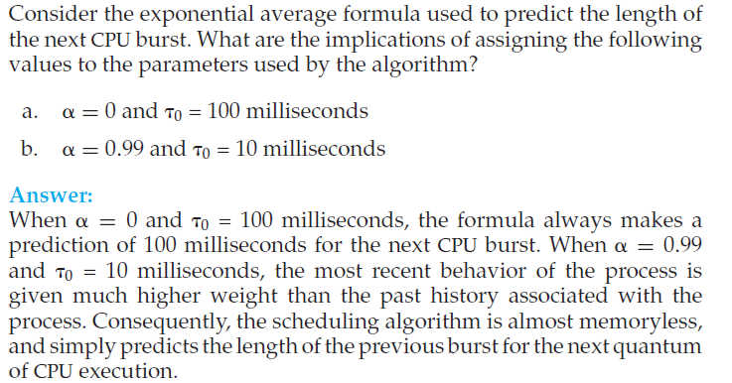
Exercise 5.5

Slide 59
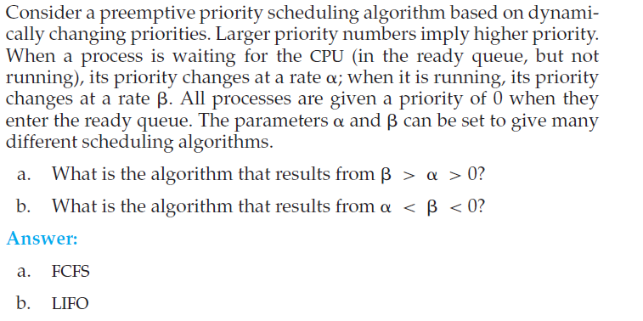
Exercise 5.14

Slide 60
Optional Exercises – 5.8
Which of the following scheduling algorithms could result in starvation?
  First-come, first-served
  Shortest job first
  Round robin
  Priority

Slide 61
Optional Exercises – 5.8
Which of the following scheduling algorithms could result in starvation?
  First-come, first-served
  Shortest job first
  Round robin
  Priority
Answer: Shortest job first and priority-based scheduling algorithms could result in starvation.

Slide 62
Optional Exercise - 5.16
Using the Windows scheduling algorithm, determine the numeric priority of each of the following threads.
  A thread in the REALTIME PRIORITY CLASS with a relative priority of NORMAL
  A thread in the ABOVE NORMAL PRIORITY CLASS with a relative priority of HIGHEST
  A thread in the BELOW NORMAL PRIORITY CLASS with a relative priority of ABOVE NORMAL

Slide 63
Optional Exercise - 5.16
Using the Windows scheduling algorithm, determine the numeric priority of each of the following threads.
  A thread in the REALTIME PRIORITY CLASS with a relative priority of NORMAL
  A thread in the ABOVE NORMAL PRIORITY CLASS with a relative priority of HIGHEST
  A thread in the BELOW NORMAL PRIORITY CLASS with a relative priority of ABOVE NORMAL
Answer:
a. 26
b. 8
c. 14

Slide 64
Optional exercise - 5.17
Assuming that no threads belong to the REALTIME PRIORITY CLASS and that none may be assigned a TIME CRITICAL priority, what combination of priority class and priority corresponds to the highest possible relative priority in Windows scheduling?

Slide 65
Optional exercise - 5.17
Assuming that no threads belong to the REALTIME PRIORITY CLASS and that none may be assigned a TIME CRITICAL priority, what combination of priority class and priority corresponds to the highest possible relative priority in Windows scheduling?
Answer:
HIGH priority class and HIGHEST priority within that class. (numeric priority of 15)

Slide 66
Optional exercise - 5.22
Consider two processes, P1 and P2, where p1 = 50, t1 = 25, p2 = 75, and t2 = 30.
  a. Can these two processes be scheduled using rate-monotonic scheduling? Illustrate your answer using a Gantt chart such as the ones in Figure 5.16–Figure 5.19.
  b. Illustrate the scheduling of these two processes using earliest- deadline-first (EDF) scheduling.

Slide 67
Optional exercise - 5.22
Consider two processes, P1 and P2, where p1 = 50, t1 = 25, p2 = 75, and t2 = 30.
  a. Can these two processes be scheduled using rate-monotonic scheduling? Illustrate your answer using a Gantt chart such as the ones in Figure 5.16–Figure 5.19.
  b. Illustrate the scheduling of these two processes using earliest- deadline-first (EDF) scheduling.
Answer:
Consider when P1 is assigned a higher priority than P2 with the rate monotonic scheduler. P1 is scheduled at t = 0, P2 is scheduled at t = 25, P1 is scheduled at t = 50, and P2 is scheduled at t = 75. P2 is not scheduled early enough to meet its deadline. When P1 is assigned a lower priority than P2, then P1 does not meet its deadline since it will not be scheduled in time.

Slide 68
Optional exercise 5.23
Explain why interrupt and dispatch latency times must be bounded in a hard real-time system.

Slide 69
Optional exercise 5.23
Explain why interrupt and dispatch latency times must be bounded in a hard real-time system.
Answer:
Following tasks: save the currently executing instruction, determine the type of interrupt, save the current process state, and then invoke the appropriate interrupt service routine. Dispatch latency is the cost associated with stopping one process and starting another. Both interrupt and dispatch latency needs to be minimized in order to ensure that real-time tasks receive immediate attention. Furthermore, sometimes interrupts are disabled when kernel data structures are being modified, so the interrupt does not get serviced immediately. For hard real-time systems, the time-period for which interrupts are disabled must be bounded in order to guarantee the desired quality of service.

Slide 70
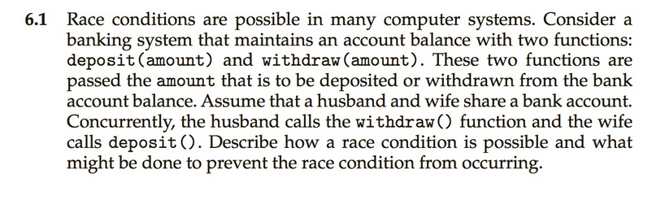
Exercise 6.1

Slide 71
6.1 Answer
Answer:
Assume the balance in the account is 250.00 and the husband calls withdraw(50) and the wife calls deposit(100). Obviously the correct value should be 300.00 Since these two transactions will be serialized, the local value of balance for the husband becomes 200.00, but before he can commit the transaction, the deposit(100) operation takes place
and updates the shared value of balance to 300.00 We then switch back to the husband and the value of the shared balance is set to 200.00 - obviously an incorrect value.

Slide 72
Exercise 7.8
Consider a system consisting of m resources of the same type being shared by n processes. A process can request or release only one resource at a time. Show that the system is deadlock free if the following two conditions hold:
  a. The maximum need of each process is between one resource and m resources.
  b. The sum of all maximum needs is less than m + n.

Slide 73
Answer 7.8
Answer:
Using the terminology of Section 7.6.2, we have:
  a. _n
  i =1 Maxi < m + n
  b. Maxi ≥ 1 for all i
  Proof: Needi = Maxi − Alloca tioni
If there exists a deadlock state then:
  c. _n
  i =1 Alloca tioni = m
Use a. to get:_ Needi + _ Alloca tioni = _ Maxi < m + n
Use c. to get:_ Needi + m < m + n
Rewrite to get:_n
i =1 Needi < n
This implies that there exists a process Pi such that Needi = 0. Since
Maxi ≥ 1 it follows that Pi has at least one resource that it can release.
Hence the system cannot be in a deadlock state.

Slide 74
Week 4 Programming Project
Purpose
  To assess your ability to:
  Explain the critical section problem.
  Present both software and hardware solutions of the critical section problem.
  Examine several classical process-synchronization problems.
  Describe several tools that are used to solve process-synchronization problems.
  Define deadlocks.
  Present a number of different methods for preventing or avoiding deadlocks in a computer system.
Action Items
Complete the following end-of-chapter exercise from your textbook:
  Programming Project: The Sleeping Teaching Assistant
Submission
Complete and submit this assignment by Saturday 2-22-14 11:59pm
Grading Criteria
0 - 20 points

Slide 75

Project 1—the Sleeping Teaching Assistant

Slide 76
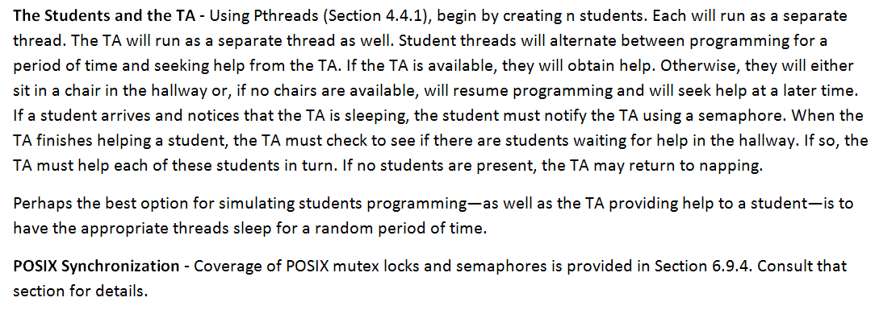
Project 1—the Sleeping Teaching Assistant

Slide 77
Optional Exercise 1
Assume a multithreaded application uses only reader—writer locks for synchronization. Applying the four necessary conditions for deadlock, is deadlock still possible if multiple reader—writer locks are used?

Slide 78
Optional Exercise 1
Assume a multithreaded application uses only reader—writer locks for synchronization. Applying the four necessary conditions for deadlock, is deadlock still possible if multiple reader—writer locks are used?
Answer: YES.
Mutual exclusion is maintained, as they cannot be shared if there is a writer.
(2) Hold-and-wait is possible, as a thread can hold one reader—writer lock while waiting to acquire another.
(3) You cannot take a lock away, so no preemption is upheld.
(4) A circular wait among all threads is possible.

Slide 79
Optional Exercise 2
Explain why interrupts are not appropriate for implementing synchronization primitives in multiprocessor systems.

Slide 80
Optional Question 2
Explain why interrupts are not appropriate for implementing synchronization primitives in multiprocessor systems.
Answer:
Interrupts are not sufficient in multiprocessor systems since disabling interrupts only prevents other processes from executing on the processor in which interrupts were disabled; there are no limitations on what processes could be executing on other processors and therefore the
process disabling interrupts cannot guarantee mutually exclusive access to program state.

Slide 81
Optional exercise 3 – section 6.2
A race condition ____.
  results when several threads try to access the same data concurrently
  results when several threads try to access and modify the same data concurrently
  will result only if the outcome of execution does not depend on the order in which instructions are executed
  None of the above

Slide 82
Optional exercise 3 – section 6.2
A race condition ____.
  results when several threads try to access the same data concurrently
  results when several threads try to access and modify the same data concurrently
  will result only if the outcome of execution does not depend on the order in which instructions are executed
  None of the above

Slide 83
Optional exercise 4 – Section 6.4
An instruction that executes atomically ____.
  must consist of only one machine instruction
  executes as a single, uninterruptible unit
  cannot be used to solve the critical section problem
  All of the above

Slide 84
Optional exercise 4 – Section 6.4
An instruction that executes atomically ____.
  must consist of only one machine instruction
  executes as a single, uninterruptible unit
  cannot be used to solve the critical section problem
  All of the above

Slide 85
Optional exercise 5 – section 6.7.2
The first readers-writers problem ____.
  requires that, once a writer is ready, that writer performs its write as soon as possible.
  is not used to test synchronization primitives.
  requires that no reader will be kept waiting unless a writer has already obtained permission to use the shared database.
  requires that no reader will be kept waiting unless a reader has already obtained permission to use the shared database.

Slide 86
Optional exercise 5 – section 6.7.2
The first readers-writers problem ____.
  requires that, once a writer is ready, that writer performs its write as soon as possible.
  is not used to test synchronization primitives.
  requires that no reader will be kept waiting unless a writer has already obtained permission to use the shared database.
  requires that no reader will be kept waiting unless a reader has already obtained permission to use the shared database.

Slide 87
Optional exercise 6 – section 6.6
What is the correct order of operations for protecting a critical section using a binary semaphore?
  release() followed by acquire()
  acquire() followed by release()
  wait() followed by signal()
  signal() followed by wait()

Slide 88
Optional exercise 6 – section 6.6
What is the correct order of operations for protecting a critical section using a binary semaphore?
  release() followed by acquire()
  acquire() followed by release()
  wait() followed by signal()
  signal() followed by wait()

Slide 89
Optional exercise 7 – section 7.1
A deadlocked state occurs whenever ____.
  a process is waiting for I/O to a device that does not exist
  the system has no available free resources
  every process in a set is waiting for an event that can only be caused by another process in the set
  a process is unable to release its request for a resource after use

Slide 90
Optional exercise 7 – section 7.1
A deadlocked state occurs whenever ____.
  a process is waiting for I/O to a device that does not exist
  the system has no available free resources
  every process in a set is waiting for an event that can only be caused by another process in the set
  a process is unable to release its request for a resource after use

Slide 91
Optional exercise 8 – section 7.5.1
Which of the following statements is true?
  A safe state is a deadlocked state.
  A safe state may lead to a deadlocked state.
  An unsafe state is necessarily, and by definition, always a deadlocked state.
  An unsafe state may lead to a deadlocked state.

Slide 92
Optional exercise 8 – section 7.5.1
Which of the following statements is true?
  A safe state is a deadlocked state.
  A safe state may lead to a deadlocked state.
  An unsafe state is necessarily, and by definition, always a deadlocked state.
  An unsafe state may lead to a deadlocked state.

Slide 93
Optional exercise 9 – section 7.1
Explain what has to happen for a set of processes to achieve a deadlocked state.

Slide 94
Optional exercise 9 – section 7.1
Explain what has to happen for a set of processes to achieve a deadlocked state.
Answer: For a set of processes to exist in a deadlocked state, every process in the set must be waiting for an event that can be caused only be another process in the set. Thus, the processes cannot ever exit this state without manual intervention.

Slide 95
Optional exercise 10 - section 7.2
True/False
The circular-wait condition for a deadlock implies the hold-and-wait condition.

Slide 96
Optional exercise 10 - section 7.2
True
The circular-wait condition for a deadlock implies the hold-and-wait condition.

Slide 97
Exercise 8.11
Program binaries in many systems are typically structured as follows. Code is stored starting with a small, fixed virtual address, such as 0. The code segment is followed by the data segment that is used for storing the program variables. When the program starts executing, the stack is allocated at the other end of the virtual address space and is allowed to grow toward lower virtual addresses. What is the significance of this structure for the following schemes?
  a. Contiguous memory allocation
  b. Pure segmentation
  c. Pure paging

Slide 98
Exercise 8.11 solution
1) Contiguous-memory allocation requires the operating system to allocate the entire extent of the virtual address space to the program when it starts executing. This could be much larger than the actual memory requirements of the process.
2) Pure segmentation gives the operating system flexibility to assign a small extent to each segment at program startup time and extend the segment if required.
3) Pure paging does not require the operating system to allocate the maximum extent of the virtual address space to a process at startup time, but it still requires the operating system to allocate a large page table spanning all of the program’s virtual address space. When a program needs to extend the stack or the heap, it needs to allocate a new page but the corresponding page table entry is preallocated.

Slide 99
Exercise 8.16
Consider a computer system with a 32-bit logical address and 4-KB page size. The system supports up to 512-MB of physical memory. How many entries are there in each of the following?
  a. A conventional single-level page table
  b. An inverted page table

Slide 100
Exercise 8.16 solution (a)
a. 2²⁰ entries - Size of logical address space = 2^{m} = of pages × page size
  2³² = of pages × 2¹² of pages =2³² / 2¹²= 2²⁰ pages

Slide 101
Exercise 8.16 solution (B)
Single Level
512MB /4K = 128K entries.
512 MB physical memory
– 2²⁹ bytes/2¹² byte pages = 2¹⁷ physical pages
Multi Level
Assume page table entry is 4 bytes
– 4 KB page / 4 bytes per page table entry =
1024 entries

Slide 102
Exercise 8.25
Assume that a system has a 32-bit virtual address with a 4-KB page size. Write a program that is passed a virtual address (in decimal) and have it output the page number and offset for the given address.
As an example, your program would run as follows
Input:
19986
Output:
The address 19986 contains: page number = 4 offset = 3602

Slide 103
Exercise 8.25 solution
Program that masks page number and offset from an unsigned 32-bit address. The size of a page is 4 KB (12 bits)
A memory reference appears as:
|------------|-----|
31 12 11 0

Slide 104
Exercise 8.25 solution
#include <stdio.h>
#include <unistd.h>
#define PAGE_NUMBER_MASK 0xFFFFF000
#define OFFSET_MASK 0x00000FFF
int main(int argc, char *argv[]) {
if (argc != 2) {
fprintf(stderr,"Usage: ./a.out <virtual address>\n");
return -1;}
int page_num, offset;
unsigned int reference;
reference = (unsigned int)atoi(argv[1]);
printf("The address %d contains:\n",reference);
// first mask the page number
page_num = (reference & PAGE_NUMBER_MASK) >> 12;
offset = reference & OFFSET_MASK;
printf("page number = %d\n",page_num);
printf("offset = %d\n",offset);
return 0;}

Slide 105
Optional Exercise 1 – Section 8.1.3
The mapping of a logical address to a physical address is done in hardware by the ________.
  memory-management-unit (MMU)
  memory address register
  relocation register
  dynamic loading register

Slide 106
Optional Exercise 2 - Section 8.1.5
In a dynamically linked library, ____.
  loading is postponed until execution time
  system language libraries are treated like any other object module
  more disk space is used than in a statically linked library
  a stub is included in the image for each library-routine reference

Slide 107
Optional Exercise 3 - Section 8.2
The _____ binding scheme facilitates swapping.
  interrupt time
  load time
  assembly time
  execution time

Slide 108
Optional Exercise 4- Section 8.3.2
_____ is the dynamic storage-allocation algorithm which results in the smallest leftover hole in memory.
  First fit
  Best fit
  Worst fit
  None of the above

Slide 109
Optional Exercise 5 - Section 8.3.2
_____ is the dynamic storage-allocation algorithm which results in the largest leftover hole in memory.
  First fit
  Best fit
  Worst fit
  None of the above

Slide 110
Optional Exercise 6 - Section 8.5
Consider a logical address with 18 bits used to represent an entry in a conventional page table. How many entries are in the conventional page table?
  262144
  1024
  1048576
  18

Slide 111
Optional Exercise 7 - Section 8.5
Given the logical address 0xAEF9 (in hexadecimal) with a page size of 256 bytes, what is the page number?
  0xAE
  0xF9
  0xA
  0x00F9

Slide 112
Optional Exercise 8 - Section 8.8
True/False
The ARM architecture uses both single-level and two-level paging.

Slide 113
Optional Exercise 9 - Section 8.6.3
True/False
Inverted page tables require each process to have its own page table.

Slide 114
Optional Exercise 10 - Section 8.5
True/False
A 32-bit logical address with 8 KB page size will have 1,000,000 entries in a conventional page table.

Slide 115
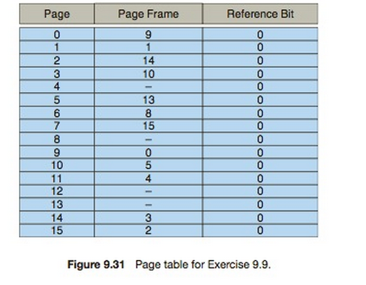
Exercise 9.9
The page table shown in Figure 9.31 is for a system with 16-bit virtual and physical addresses and with 4,096-byte pages.
The reference bit is set to 1 when the page has been referenced. Periodically, a thread zeroes out all values of the reference bit.
A dash for a page frame indicates the page is not in memory.
The page-replacement algorithm is localized LRU, and all numbers are provided in decimal.

Slide 116
Exercise 9.9
Convert the following virtual addresses (in hexadecimal) to the equivalent physical addresses. You may provide answers in either hexadecimal or decimal. Also set the reference bit for the appropriate entry in the page table.
  0xE12C • 0x3A9D • 0xA9D9 • 0x7001 • 0xACA1
Using the above addresses as a guide, provide an example of a logical address (in hexadecimal) that result in a page fault.
From what set of page frames will the LRU page-replacement algorithm choose in resolving a page fault?

Slide 117
Exercise 9.9 solution
Answer:
◦ 0xE12C→0x312C
◦ 0x3A9D→0xAA9D
◦ 0xA9D9→0x59D9
◦ 0x7001→0xF001
◦ 0xACA1→0x5CA1
• The only choices are pages 4, 8, 12, and 13. Thus, example addresses
include anything that begins with the hexadecimal sequence
0x4..., 0x8..., 0xC..., and 0xD....
• Any page table entries that have a reference bit of zero. This includes
the following frames {9, 1, 14, 13, 8, 0, 4}

Slide 118
Exercise 9.12
Discuss situations in which the most frequently used (MFU) page- replacement algorithm generates fewer page faults than the least recently used (LRU) page-replacement algorithm.
Also discuss under what circumstances the opposite holds.

Slide 119
Exercise 9.12 solution
Answer:
Consider the sequence in a system that holds four pages in memory: 1 2 3 4 4 4 5 1. The most frequently used page replacement algorithm evicts page 4while fetching page 5, while the LRU algorithm evicts page 1. This is unlikely to happen much in practice. For the sequence “1 2 3 4 4 4 5 1,” the LRU algorithm makes the right decision.

Slide 120
Programming Project: Exercise 9.26
Write a program that implements the FIFO, LRU, and optimal page- replacement algorithms presented in this chapter.
First, generate a random page-reference string where page numbers range from 0 to 9.
Apply the random page-reference string to each algorithm and record the number of page faults incurred by each algorithm.
Implement the replacement algorithms so that the number of page frames can vary from 1 to 7. Assume that demand paging is used.

Slide 121
Programming Project: Exercise 9.26
First, generate a random page reference string where page numbers range from 0 to 9.
Apply the random page-reference string to each algorithm, and record the number of page faults incurred by each algorithm.
Implement the replacement algorithms so that the number of page frames can vary as well. Assume that demand paging is used.
Your algorithms will be based on the abstract class depicted in Figure 9.2.

Slide 122
Replacement algorithm
public abstract class ReplacementAlgorithm
{
// the number of page faults protected int pageFaultCount;
// the number of physical page frame protected int pageFrameCount;
// pageFrameCount - the number of physical page frames public
ReplacementAlgorithm(int pageFrameCount) {
if (pageFrameCount < 0)
throw new IllegalArgumentException();
this.pageFrameCount = pageFrameCount; pageFaultCount = 0; }
// return - the number of page faults that occurred. public int getPageFaultCount() {
return pageFaultCount;
}
// int pageNumber - the page number to be inserted
public abstract void insert(int pageNumber); }

Slide 123
Programming Project: Exercise 9.26
Design and implement two classes—LRU and FIFO—that extend ReplacementAlgorithm.
Each of these classes will implement the insert() method, one class using the LRU page-replacement algorithm and the other using the FIFO algorithm.
PageGenerator—a class that generates page-reference strings with page numbers ranging from 0 to 9. The size of the reference string is passed to the PageGenerator constructor.
PageGeneratorobjectisconstructed,thegetReferenceString() method returns the reference string as an array of integers.
Test—used to test your FIFO and LRU implementations of the ReplacementAlgorithm abstract class. Test is invoked as
java Test <reference string #> <# of page frames>

Slide 124
Resources
http://codex.cs.yale.edu/avi/os-book/OSE2/java-dir/9.pdf
http://cprogrammingguide.wordpress.com/2012/07/10/simulation-of-page-replacement-algorithms-fifo-lru-optimal/
http://codearea.in/page-replacement-algorithms-fifo-lru-optimal/

Slide 125
Optional Exercise 1- Section 9.1
Which of the following is a benefit of allowing a program that is only partially in memory to execute?
  Programs can be written to use more memory than is available in physical memory.
  CPU utilization and throughput is increased.
  Less I/O is needed to load or swap each user program into memory.
  All of the above

Slide 126
Optional Exercise 2 - Section 9.4.2
Suppose we have the following page accesses: 1 2 3 4 2 3 4 1 2 1 1 3 1 4 and that there are three frames within our system. Using the FIFO replacement algorithm, what is the number of page faults for the given reference string?
  14
  8
  13
  10

Slide 127
Optional Exercise 3 – Section 9.4.2
Suppose we have the following page accesses: 1 2 3 4 2 3 4 1 2 1 1 3 1 4 and that there are three frames within our system. Using the FIFO replacement algorithm, what will be the final configuration of the three frames following the execution of the given reference string?
  4, 1, 3
  3, 1, 4
  4, 2, 3
  3, 4, 2

Slide 128
Optional Exercise 4 – Section 9.4.4
Given the reference string of page accesses: 1 2 3 4 2 3 4 1 2 1 1 3 1 4 and a system with three page frames, what is the final configuration of the three frames after the LRU algorithm is applied?
  1, 3, 4
  3, 1, 4
  4, 1, 2
  1, 2, 3

Slide 129
Optional Exercise 5 – section 9.4
_____ is the algorithm implemented on most systems.
  FIFO
  Least frequently used
  Most frequently used
  LRU

Slide 130
Optional Exercise 6 – section 9.6
_____ occurs when a process spends more time paging than executing.
  Thrashing
  Memory-mapping
  Demand paging
  Swapping

Slide 131
Optional Exercise 7 – section 9.7
______ allows a portion of a virtual address space to be logically associated with a file.
  Memory-mapping
  Shared memory
  Slab allocation
  Locality of reference

Slide 132
Optional Exercise 8 – Section 9.1
True/False
In general, virtual memory decreases the degree of multiprogramming in a system.

Slide 133
Optional Exercise 9 – section 9.2.2
How is the effective access time computed for a demand-paged memory system?
Answer: In order to compute the effective access time, it is necessary to know the average memory access time of the system, the probability of a page fault, and the time necessary to service a page fault. The effective access time can then be computed using the formula:
effective access time = (1 – probability of page fault) * memory access time + probability of page fault * page fault time.

Slide 134
Optional Exercise 10 – section 9.8
Which of the following statements is false with regard to allocating kernel memory?
  Slab allocation does not suffer from fragmentation.
  Adjacent segments can be combined into one larger segment with the buddy system.
  Because the kernel requests memory of varying sizes, some of which may be quite small, the system does not have to be concerned about wasting memory.
  The slab allocator allows memory requests to be satisfied very quickly.

Slide 135
10.6
If the operating system knew that a certain application was going to access file data in a sequential manner, how could it exploit this information to improve performance?
Answer:
When a block is accessed, the file system could prefetch the subsequent blocks in anticipation of future requests to these blocks. This prefetching
Optimization would reduce the waiting time experienced by the process for future requests.

Slide 136
10.7
Give an example of an application that could benefit from operating- system support for random access to indexed files.
Answer:
An application that maintains a database of entries could benefit from
such support. For instance, if a program is maintaining a student
database, then accesses to the database cannot be modeled by any
predetermined access pattern. The access to records are random and
locating the records would be more efficient if the operating system
were to provide some form of tree-based index.

Slide 137
11.7
Consider a file system on a disk that has both logical and physical block sizes of 512 bytes. Assume that the information about each file is already in memory. For each of the three allocation strategies (contiguous, linked, and indexed), answer these questions:
  a. How is the logical-to-physical address mapping accomplished in this system? (For the indexed allocation, assume that a file is always less than 512 blocks long.)
  b. If we are currently at logical block 10 (the last block accessed was block 10) and want to access logical block 4, how many physical blocks must be read from the disk?

Slide 138
11.7 - Solution
Let Z be the starting file address (block number).
• Contiguous. Divide the logical address by 512 with X and Y the
resulting quotient and remainder respectively.
  a. Add X to Z to obtain the physical block number. Y is the
  displacement into that block.
  b. 1
• Linked. Divide the logical physical address by 511 with X and Y
the resulting quotient and remainder respectively.
  a. Chase down the linked list (getting X + 1 blocks). Y + 1 is the
  displacement into the last physical block.
  b. 4
• Indexed. Divide the logical address by 512 with X and Y the
resulting quotient and remainder respectively.
  a. Get the index block into memory. Physical block address is
  contained in the index block at location X. Y is the displacement
  into the desired physical block.
  b. 2

Slide 139
Optional exercise 1 – Section 10.1
Suppose that the operating system uses two internal tables to keep track of open files. Process A has two files open and process B has three files open. Two files are shared between the two processes. How many entries are in the per-process table of process A, the per-process table of process B, and the system-wide tables, respectively?
  5, 5, 5
  2, 3, 3
  2, 3, 5
  2, 3, 1

Slide 140
Optional exercise 2 – Section 10.1
An exclusive lock ____.
  behaves like a writer lock
  ensures that a file can have only a single concurrent shared lock
  behaves like a reader lock
  will prevent all other processes from accessing the locked file

Slide 141
Optional exercise 3 – Section 10.2.1
The simplest file access method is ____
  sequential access.
  logical access.
  relative access.
  direct access.

Slide 142
Optional exercise 4 – Section 10.1.2
If you were creating an operating system to handle files, what would be the six basic file operations that you should implement?
Answer: The six basic file operations include: creating a file, writing a file, reading a file, repositioning within a file, deleting a file, and truncating a file. These operations comprise the minimal set of required file operations.

Slide 143
Optional exercise 5 – Section 10.3.5
Distinguish between an absolute path name and a relative path name.
Answer: An absolute path name begins at the root and follows a path of directories down to the specified file, giving the directory names on the path. An example of an absolute path name is
/home/osc/chap10/file.txt. A relative path name defines a path from the current directory. If the current directory is /home/osc/, then the relative path name of chap10/file.txt refers to the same file as in the example of the absolute path name.

Slide 144
Optional exercise 6 – Section 11.1
Transfers between memory and disk are performed a ____.
  byte at a time
  file at a time
  block at a time
  sector at a time

Slide 145
Optional exercise 7 – section 11.1
Order the following file system layers in order of lowest level to highest level.
[1] I/O control
[2] logical file system
[3] basic file system
[4] file-organization module
[5] devices
  1, 3, 5, 4, 2
  5, 1, 3, 2, 4
  1, 5, 3, 4, 2
  5, 1, 3, 4, 2

Slide 146
Optional exercise 9 – Section 11.1
______ includes all of the file system structure, minus the actual contents of files.
  Metadata
  Logical file system
  Basic file system
  File-organization module

Slide 147
Optional exercise 8 – Section 11.3.2
How is a hash table superior to a simple linear list structure? What issue must be handled by a hash table implementation?
Answer: A hash table implementation uses a linear list to store directory entries. However, a hash data structure is also used in order to speed up the search process. The hash data structure allows the file name to be used to help compute the file's location within the linear list. Collisions, which occur when multiple files map to the same location, must be handled by this implementation.

Slide 148
Optional exercise 10 – Section 11.4.2
How many disk accesses are necessary for direct access to byte 20680 using linked allocation and assuming each disk block is 4 KB in size?
  1
  6
  7
  5

